Slide 1
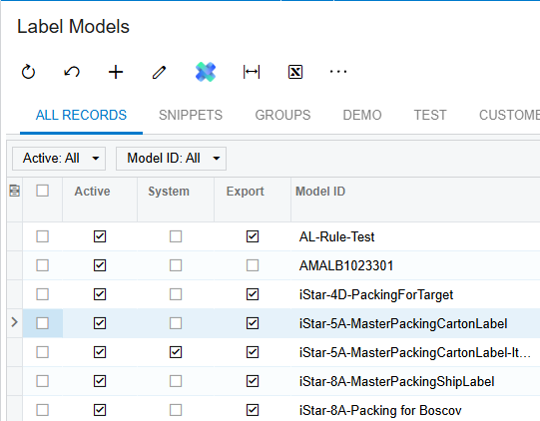
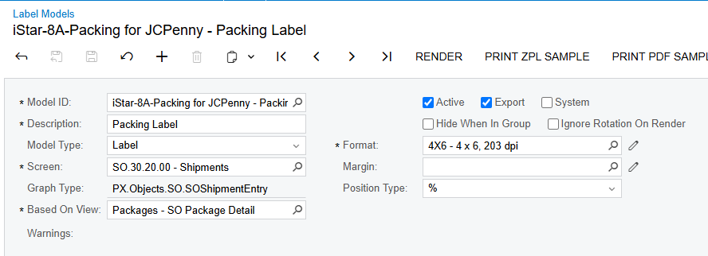
Add new label
1) Set up name
2) Add Model Number
3) Add Shipments in “Screen”, Packages in “Based on View”, and 4x6 in “Format”

Slide 2
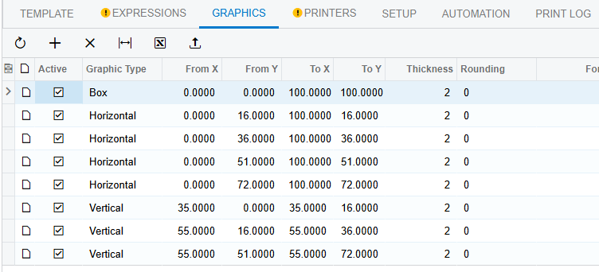
Setting up boxes/lines
1) In graphics, set up the boxes
2) Change the parameters based on what parameters are being added

Slide 3
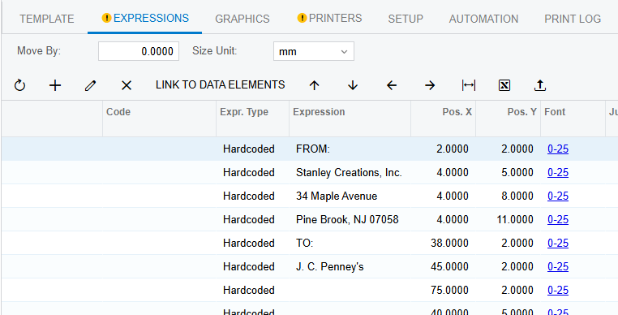
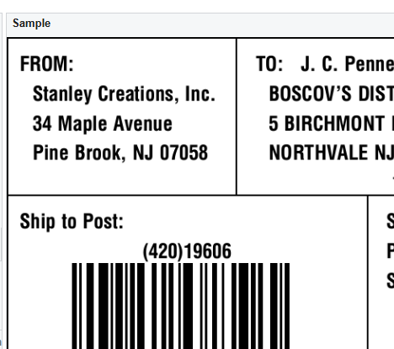
Setting up details
1) In Expressions, set up the fields from the other screens.
(1)
(2)
Order things in the list of the details based on Left – Downward, separated by box

Slide 4
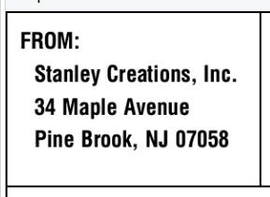
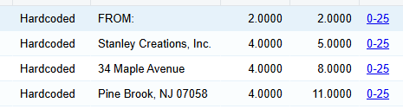
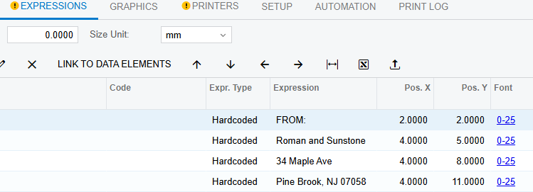
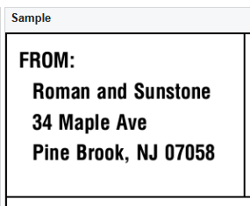
From Address Box
Should be the same address whether from Stanly or iStar/Roman and Sunstone

Slide 5
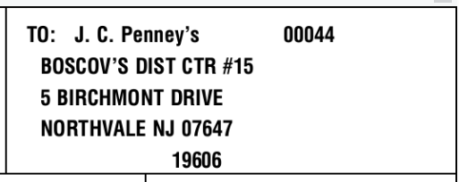
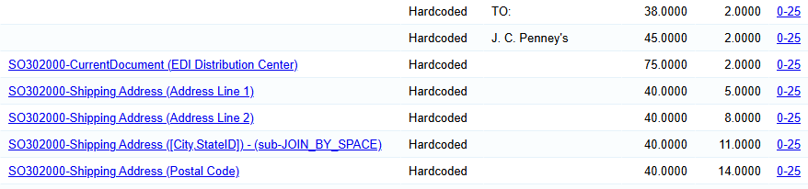
To Address Box
List the address the package is going to

Slide 6
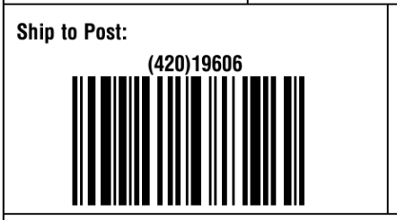
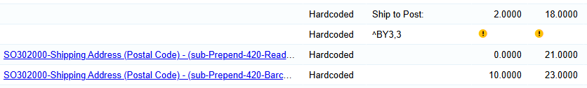
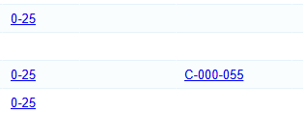
Ship to Post Box
Postal code number and barcode
Add this under column Justification
Add this code under Expression Column
Changes barcode’s size to make it fit

Slide 7
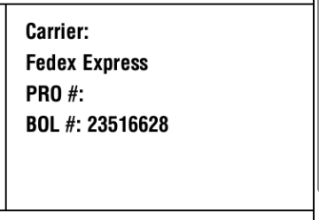
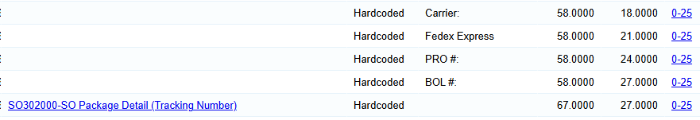
Carrier Box
Place Carrier information here

Slide 8
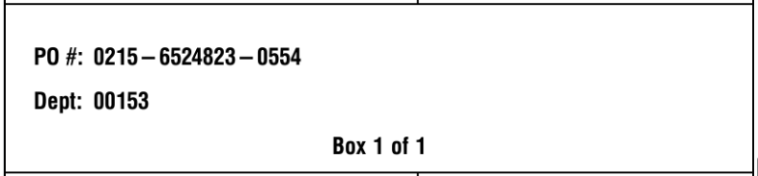
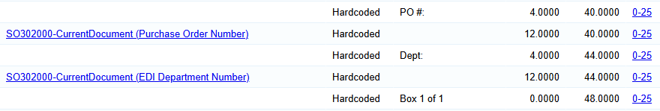
PO / Box info Box
PO information
May also include Box information

Slide 9
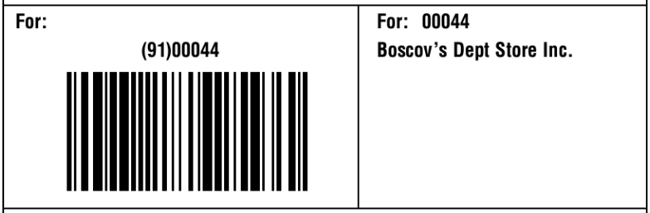
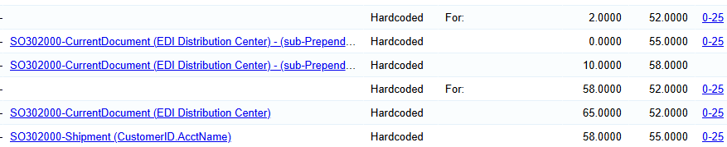
Distribution Box
Barcode and info boxes.

Slide 10
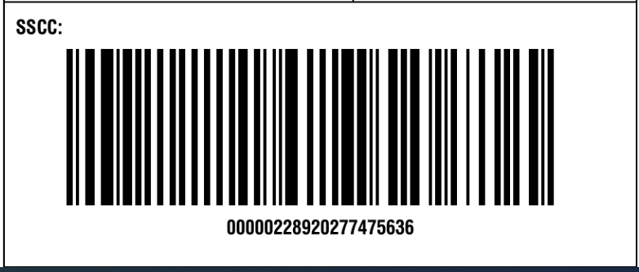
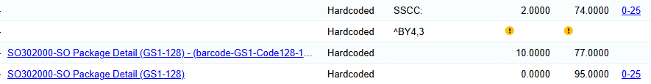
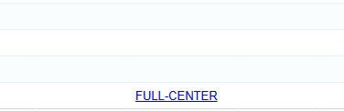
SSCC Box
Contains SSCC barcode. Should be at the bottom most of the time.
Need this code keep size of barcode within box

Slide 11
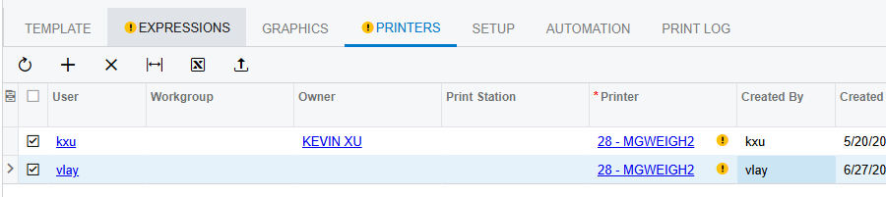
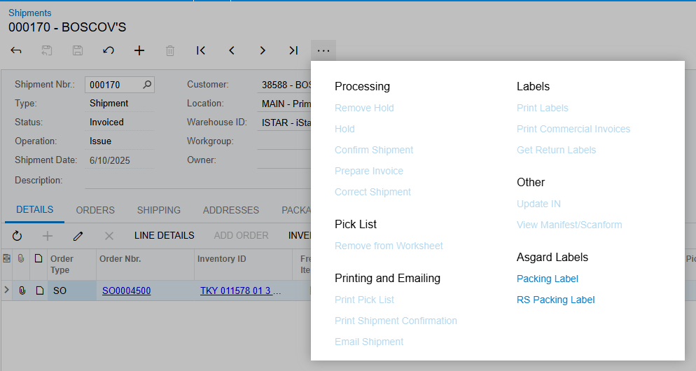
Add Printer
1) In printer tab, add a new line
2) Add your username so that the label will appear as a printing option on the screen
3) Add printer

Slide 12
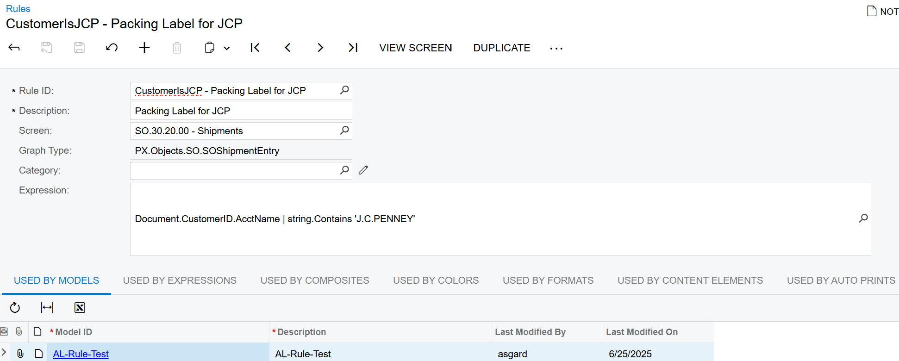
Create Rule
1) Set up name
3) Type in the conditions of the rule

Slide 13
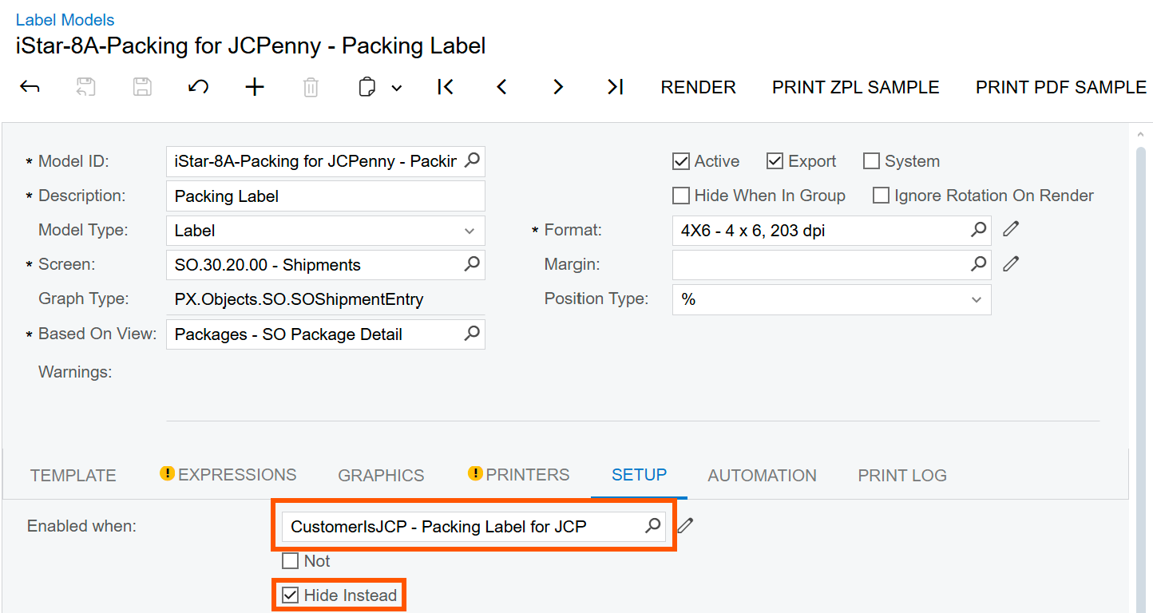
Add the rule in the label model
1) Add rule in “Enable when” box
1) Tick “Hide Instead” when rule is met

Slide 14
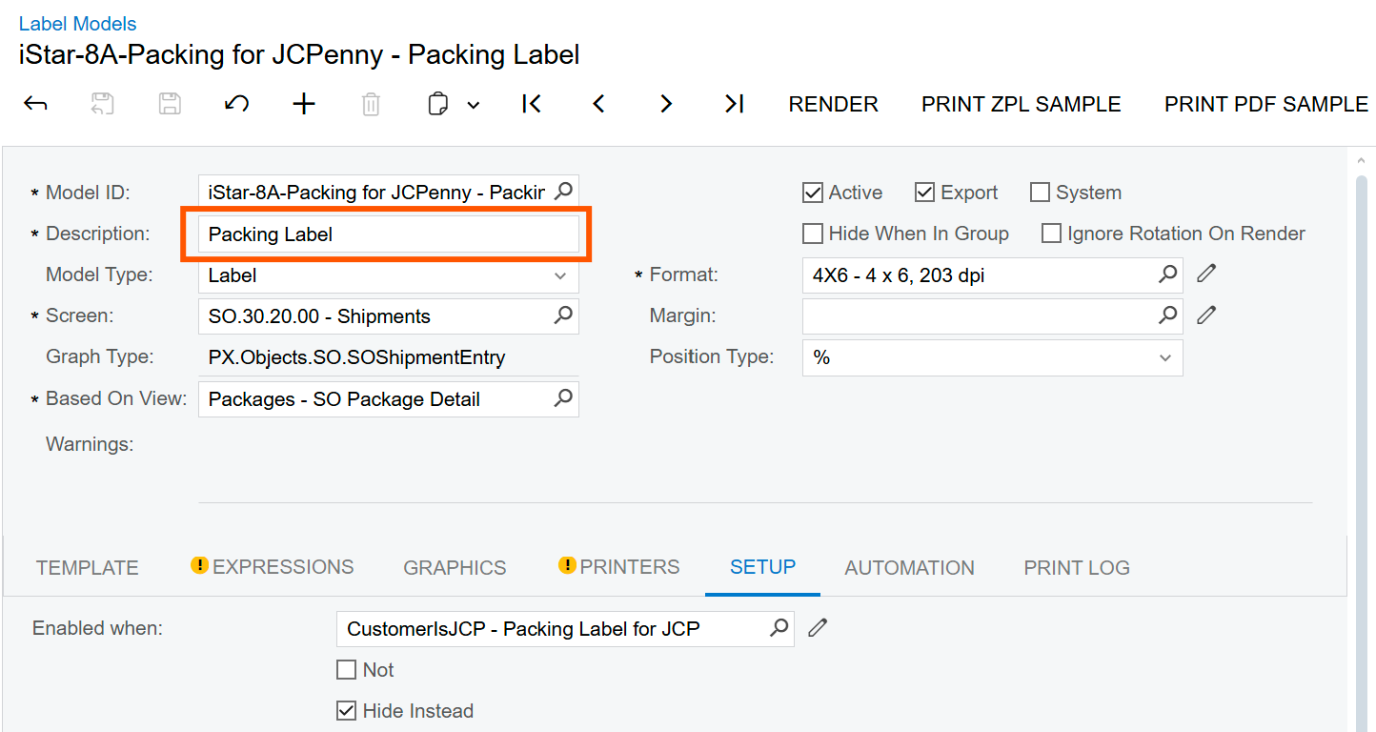
Extra
Change the description to prevent wordiness. This is what shows up when printing the label in another screen

